Slide 1
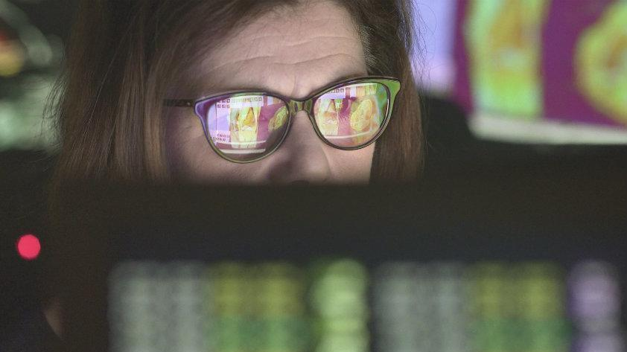
Technology & Eyestrain
By: Evan B

Slide 2
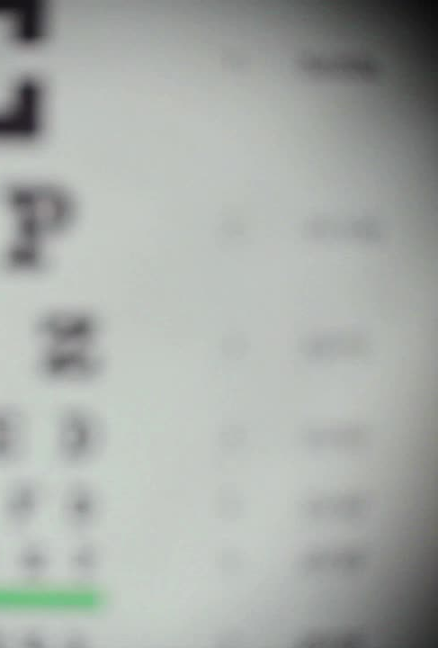
What Is Eye Strain?
Eyestrain is defined as the following: “Eyestrain is a common condition that occurs when your eyes get tired from intense use, such as driving long distances, or staring at computer screens and other digital devices.” – Google

Slide 3
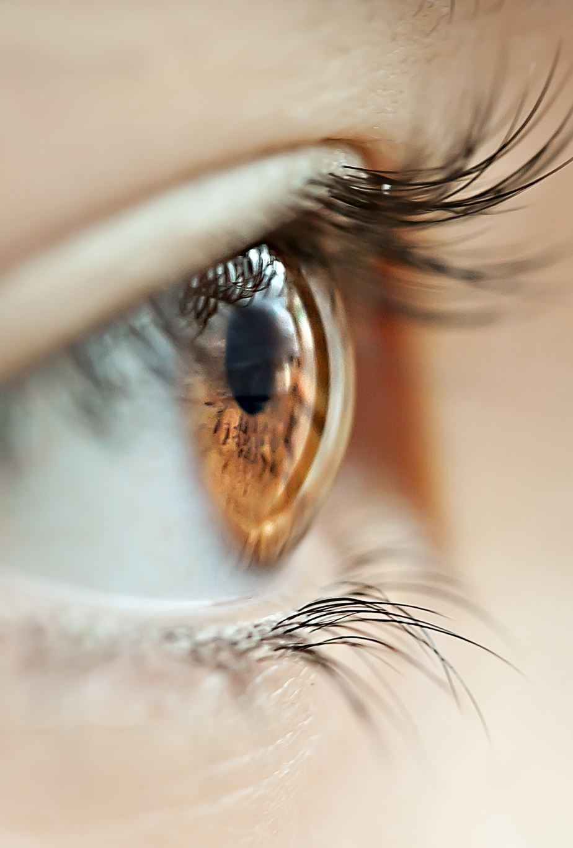
How Do You Know If You Have It?
There are quite a few symptoms of eyestrain, since it is common to get for computer programmers, the symptoms include; sore, itching, or burning eyes, watery or dry eyes, blurred or double vision, headaches, sore neck, difficulty concentrating, and increased sensitivity to light.

Slide 4
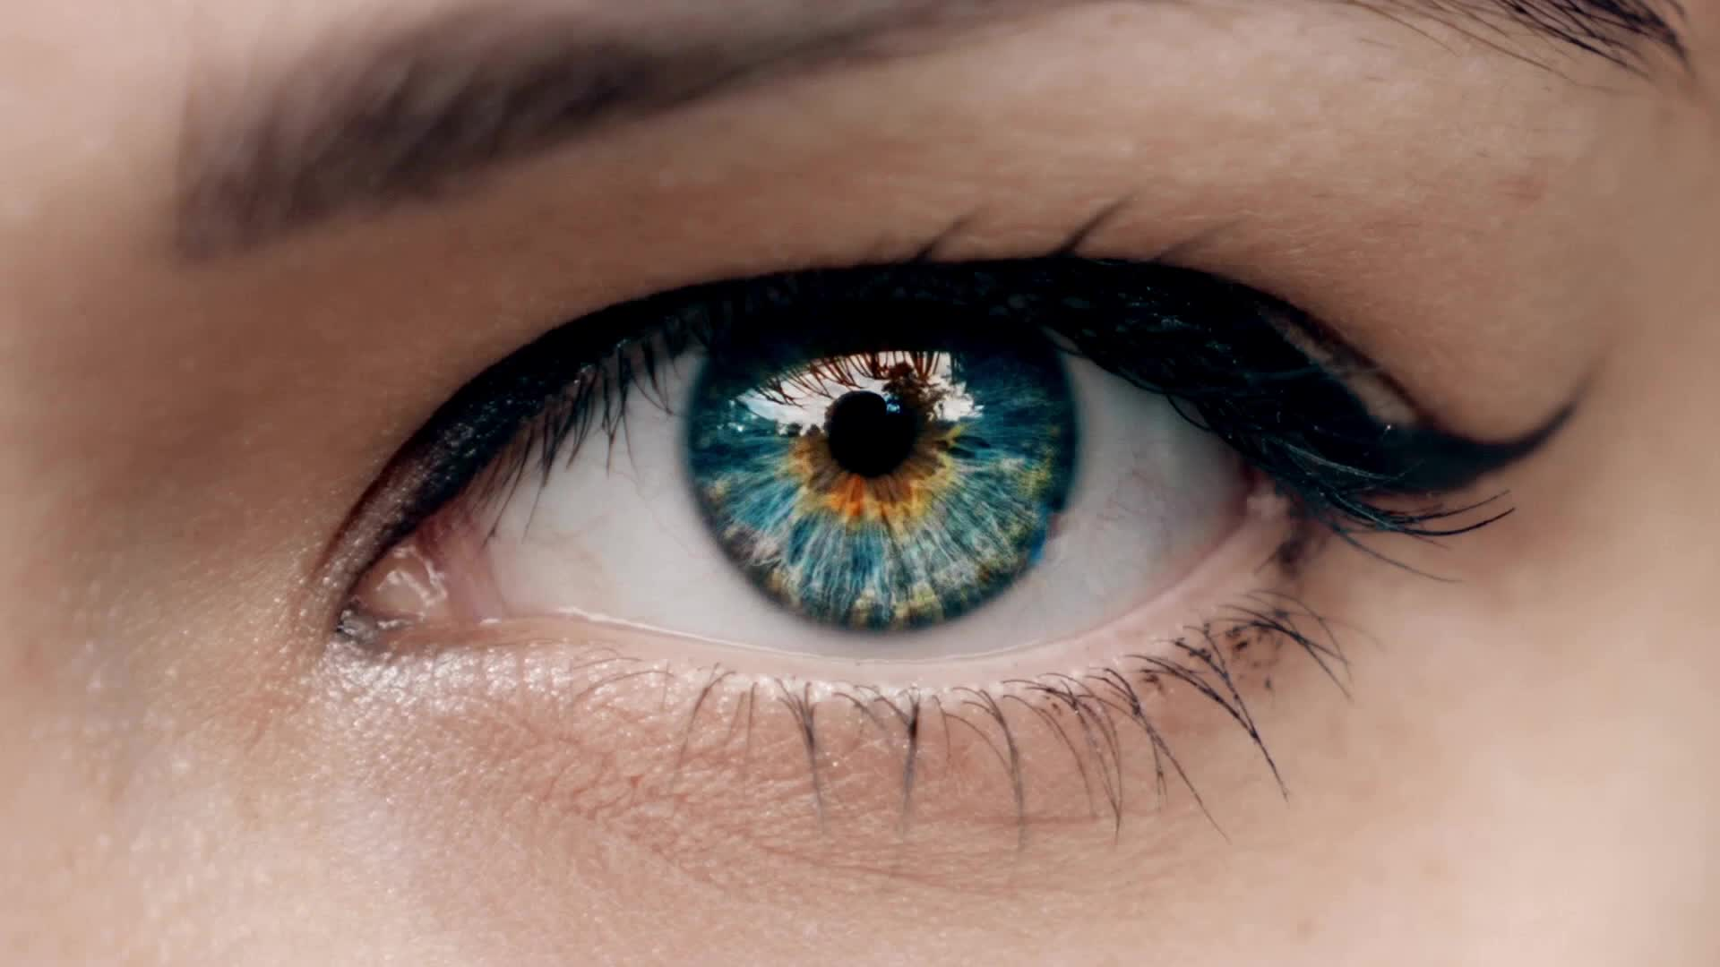
Is Eyestrain A Serious Condition?
Although Eyestrain is common it is most likely not serious, it just indicates that you need to take action to help your eyes out, or to take a break. It can be considered serious in some cases it'll mean you have an underlying eye condition that needs treatment.

Slide 5

How Long Does It Last?
Eyestrain doesn’t take long to get when combined with computers, after a couple hours in front of a screen, can get you about an hour of eyestrain. This Knowledge was also found out by many workers who spend 8 or more hours in front of a screen.

Slide 6
How to Help This Condition
There are quite a few solutions for this which we will cover over the next few slides. The first solution being to gently light up the room around you, this will make it easier on your eyes and reduce your chances of eyestrain.

Slide 7
Solution #2
The next possible solution would be to take breaks/limit screen time, this will give your eyes a time to relax, and moisturize themselves. Each break should go for at least 15 minutes.

Slide 8
Solution #3
The 3rd solution would be to use artificial tears which would help moisturize your eyes, this will reduce the tiredness of them and make it easier to function.

Slide 9
Solution #4
The 4th solution would be to improve the airspace around you, this would help a lot, you could consider adding a humidifier, adjusting the thermostat, and avoiding smoke, moving your area could also help change the amount of dry moving air going at you.

Slide 10
Solution #5
The final solution would be to wear blue light resistant glasses, which is a main cause for restlessness, and even the cause for many factors of eyestrain. Blue light resistant glasses go for around $100 and can help drastically.

Slide 11

Thanks For Reading!

